Slide 1
INTELLIGENT INFORMATION ACCESS AND NATURAL LANGUAGE PROCESSING
Emotional City
Professors:
Giovanni SEMERARO
Pierluigi CASSOTTI
Student:
Davide DI PIERRO

Slide 2




WHAT IS EMOTIONAL CITY
Emotional City is an integrated platform that, through public sources (newspapers, social platforms, opendata, etc.) carries out an NLP pipeline that involves sentiment analysis process and lexical semantic change detection.

Slide 3
PIPELINE
01
02
03
DATA EXTRACTION
API IMPLEMENTATION
RETRIEVE DATA
Extraction of tweets from Twitter
Python application for looking for data
Emotional City for retrieving data

Slide 4
DATA EXTRACTION

Slide 5
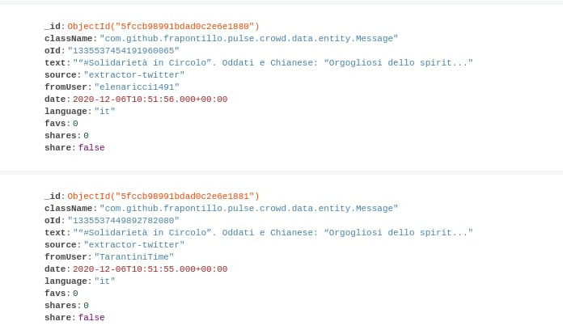
CROWD PULSE
For data extraction, I used Crowd Pulse. It is a platform which provides a graphic interface to visualize data extracted from Twitter. The extraction can be done writing a configuration file in JSON.
I decided to use Crowd Pulse because of its easiness of use and the large number of operations it provides. These operations or extensions are called plugins.

Slide 6
AVAILABLE PLUGINS
email-notify social-twitter
social-facebook data-java
detect-language-optimaize geo-profile-google-maps
geo-message-from-profile index-uniba
tag-babelfy tag-me
tag-open-calais tag-wikipedia-miner
categorize-wikipedia tokenize-open-nlp
lemmatize-morphit lemmatize-stanford-corenlp
lemmatize-multi pos-tag-open-nlp
pos-tag-simple-it pos-tag-simple-en
pos-tag-simple-multi rem-stop-word-simple
infogram sentiment-sentit
sentiment-sentiwordnet

Slide 7
social-twitter
This plugin will be used to retrieve tweets. There are different filters available:
Based on content (terms, hashtag, etc.);
Based on user (sent and received);
Based on geo-coordinates(bounding_box approach);
Based on filters (language, date, etc.);
Combination of filters;
The plugin is named "extractor-twitter“. This is the extractor we will use for Emotional City:
{ "process": { …},
"nodes": {
"message-extractor": {
"plugin": "extractor-twitter",
"config": {
"query": [
"puglia",
…
],
“location”: "14.7748476736", "39.6176788304", "19.0160785326", "42.2822860976",
"since": "2019-07-01",
"language": "it"
}
},
"message-persister": { …}
},
"edges": { … } }

Slide 8
data-java
For storing the data, the message-persist plugin must be used. The only parameter in the configuration is the name of the database on which data will be stored. This plugin is already present in the previous slide:
"message-persister": {
"plugin": "message-persist",
"config": {
"db": "emotionalcity"
}
}
At the end of the extraction and saving, we can see the amount of data collected per time period through Crowd Pulse. This is an example of data collected only in one day (just for example).

Slide 9
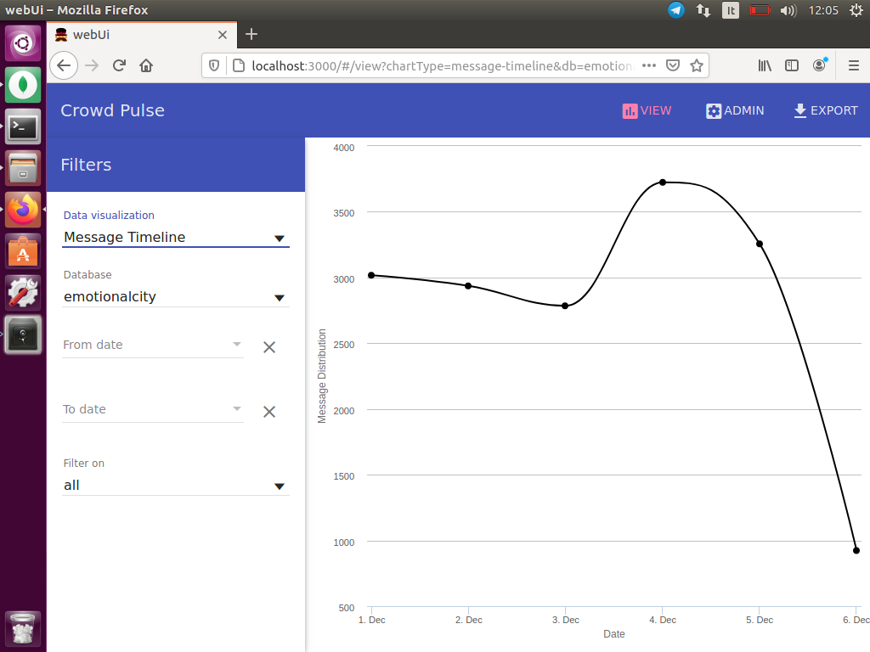
Message Timeline

Slide 10
tokenize-opennlp
This plugin tokenizes data previously retrieved. The tokenization is the process in which we read a text and separate the different words. In some cases, we also filter some words for example removing those which are shorter than three letters or represent an url.
This is the configuration for Emotional City:
{
"process": { … },
"nodes": {
"fetch": { … },
"tokenizer": {
"plugin": "tokenizer-opennlp",
"config": {
"minChars": "4",
"mentions": "true",
"urls": "true",
"hashtags": "false",
"calculate": "new"
}
},
"persistance": { … }
},
"edges": { … }
}

Slide 11
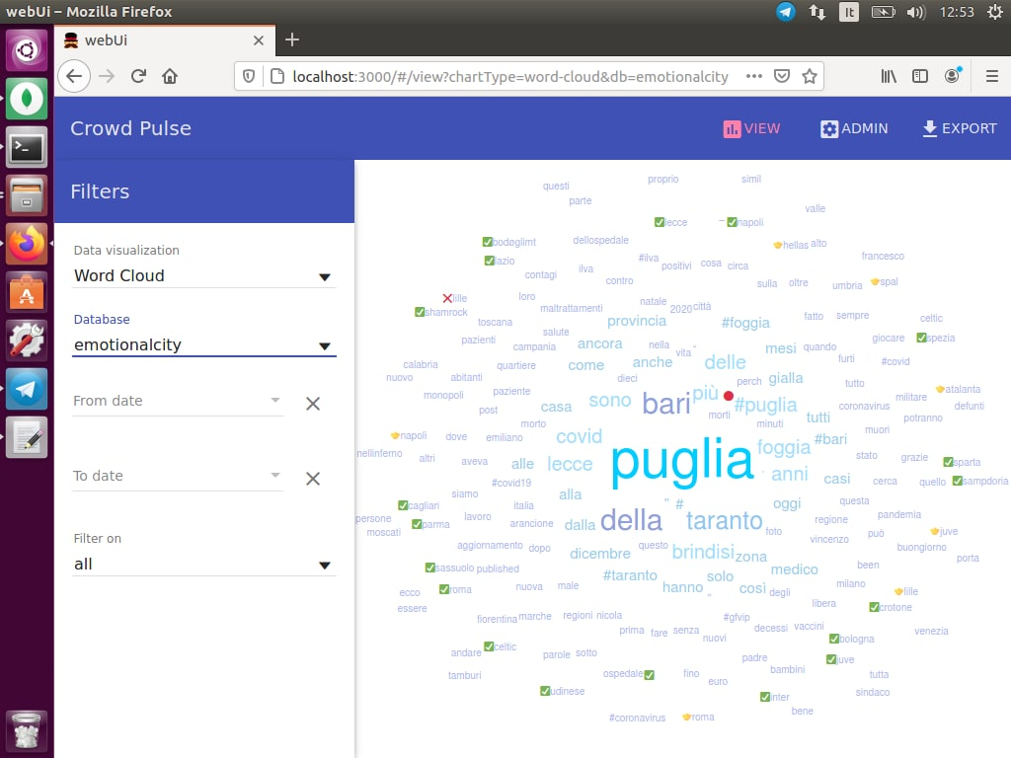
Word Cloud

Slide 12
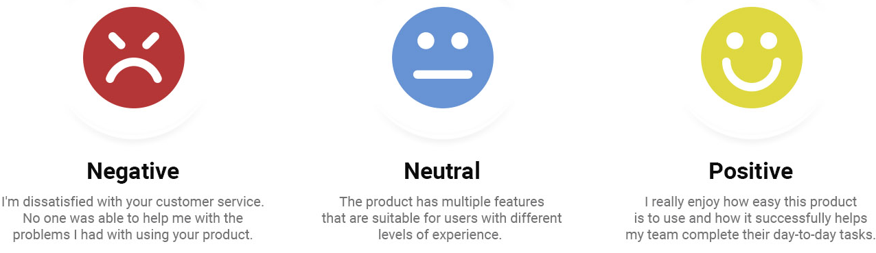
sentiment-sentit
This plugin provides the sentiment analysis of the tweets. Sentiment analysis algorithms associate a polarity (negative, neutral, positive) to each tweet.
It performs a Machine Learning algorithm called SentIt that returns the polarity of tweets (1: positive, 0:neutral, -1:negative). This is preferred to the approach with SentiWordNet and MultiWordNet because it has been realized from the University of and so we can have access without limits. The plugin does not require any parameters.
"sentiment": {
"plugin": "sentiment-sentit",
"config": {
"calculate": "new"
}
}

Slide 13
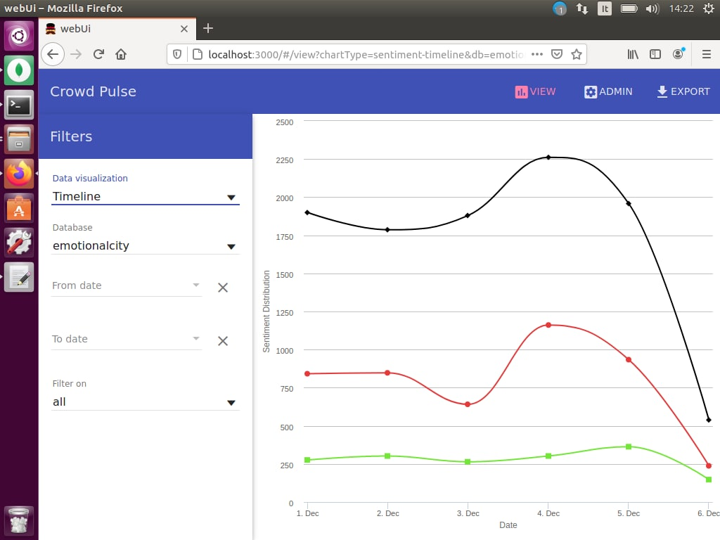
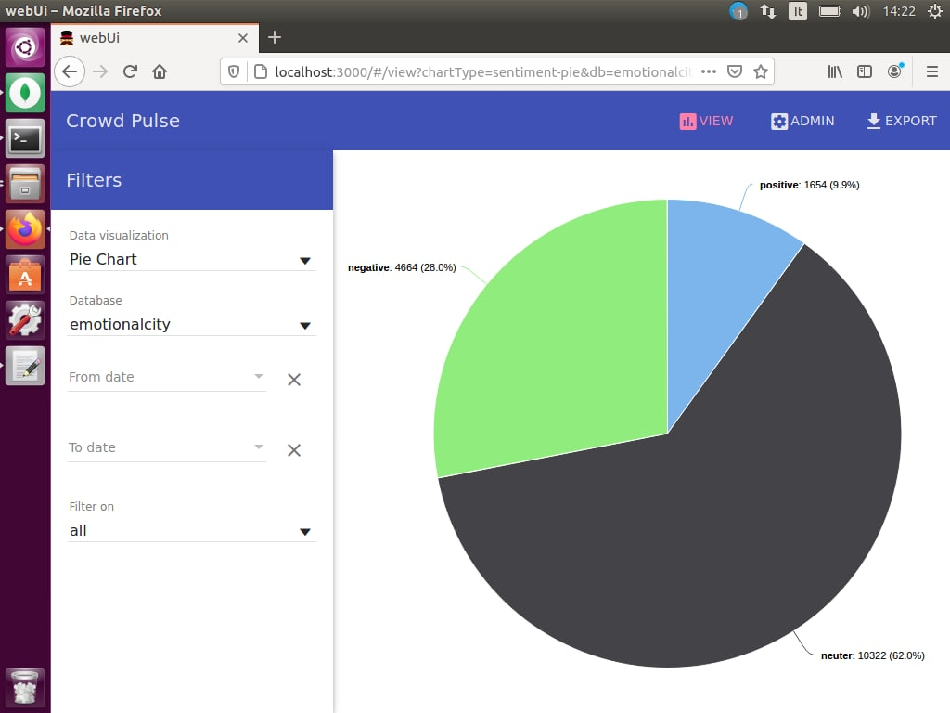
Timeline and Pie Chart

Slide 14
API IMPLEMENTATION

Slide 15
twitter_requests.py
I chose to develop an application in Python since it fits very well for analysis problem. It is also object-oriented and provides a lot of functions to connect to MongoDB databases. These are the functions I developed:
writeLogs
createTweet;
count_tweets;
count_tweets_time;
int2time;
time2int;
string2int;
senti_tweets;
senti_tweets_time;
geo_count_tweets;
geo_count_tweets_time;
geo_senti_tweets;
geo_senti_tweets_time;
search_tweets;
search_tweets_time;
search_geo_tweets;
search_geo_tweets_time;
backup;
read_backups;
get_log;

Slide 16
Considerations and future expansions
Considerations:
Emotional City is a powerful tool to discover opinions about specific topics during period of times;
If integrated in a platform, it can represent a source of knowledge for citizens. The more public information is available, the more the community feels part of the society;
It can be also useful to understand the behavior of the people in social by monitoring the amount of tweets during some period or by specific zones;
If citizens start to use it frequently, it can become a cultural symbol for the Apulia region.
Future expansions:
twitter_requests.py must be integrated in a platform that can be queried by end users;
New tweets must be gathered, even from many years ago if we would like to keep track of opinions during time;
Integrating data coming from other sources;

Slide 17
THANKS
Do you have any questions?
d.dipierro7@studenti.uniba.com

